Slide 2
Food. The Cornerstone of National Security
Mitch Frazier
@Mitchdf
@AgriNovusIN

Slide 3
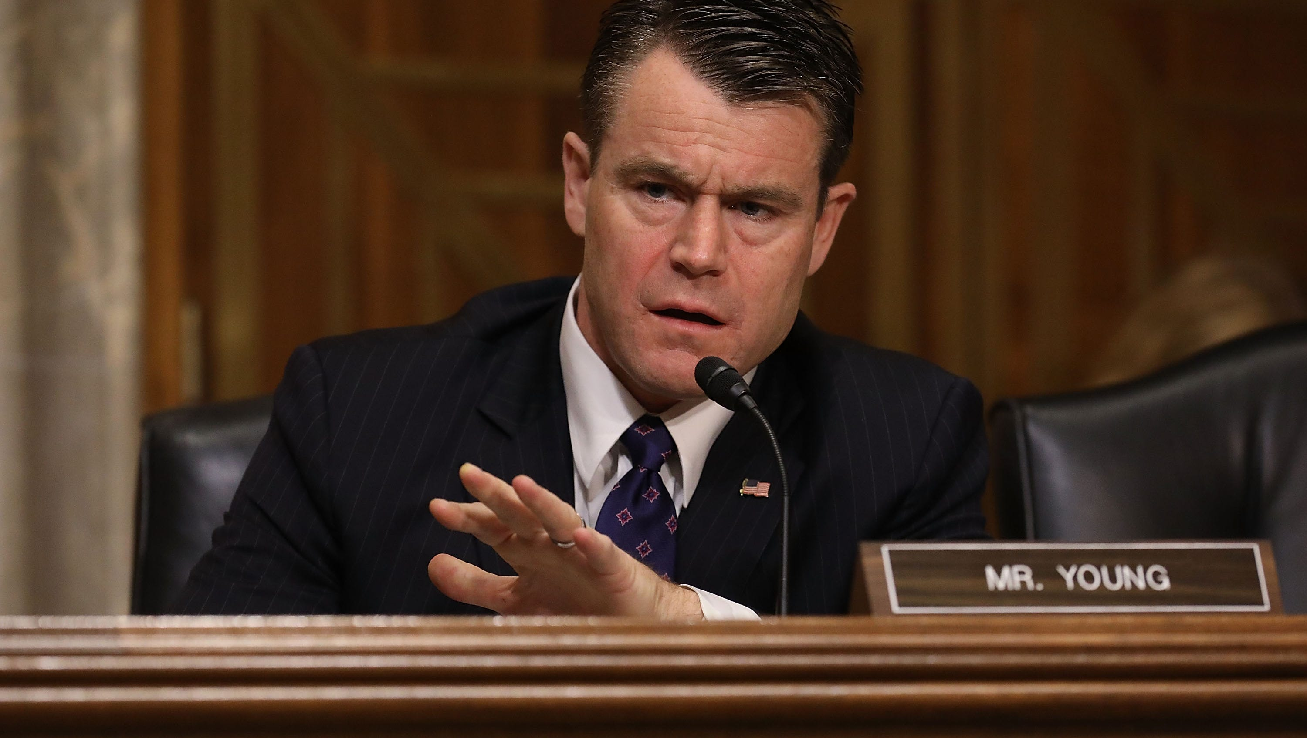
Getty Images. 2017.
Notes:
In a March 2018 meeting of the Senate Committee on Foreign Relations aptly entitled ‘Why Food Security Matters,’ Senator Young referenced a powerful statement from a retired Marine Lieutenant General – “food crises grow terrorists.”

Slide 4
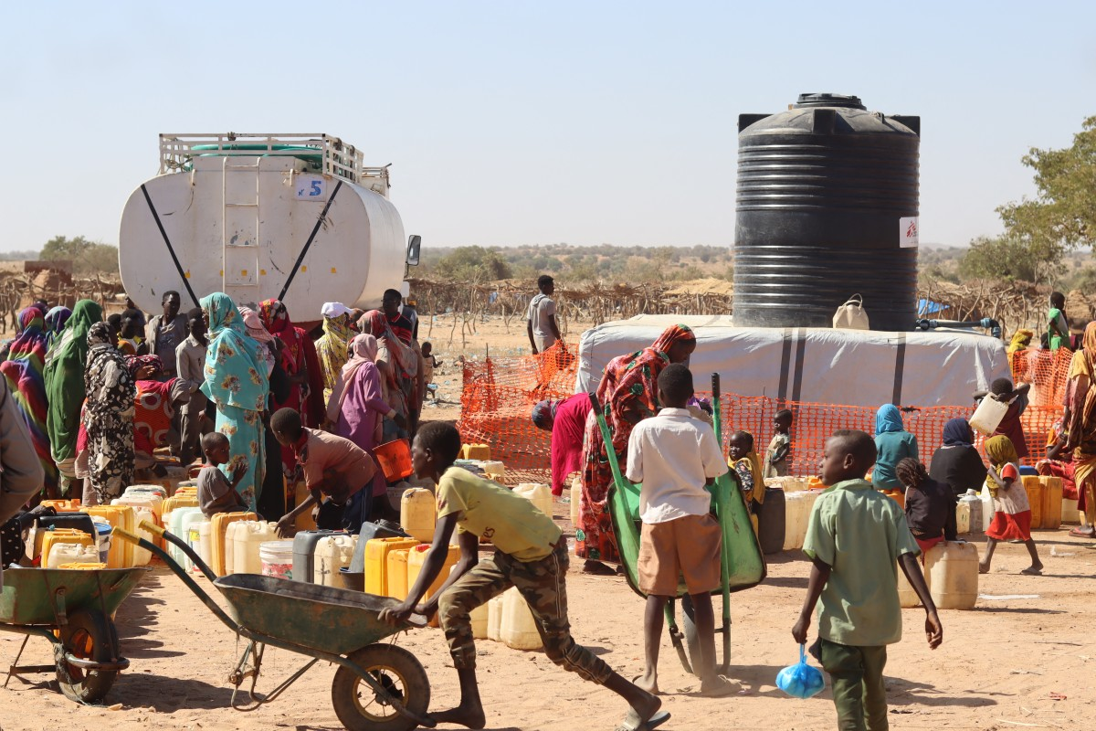
AFP. 2023.
Notes:
Since Sudan's war spread to Al-Jazira state south of Khartoum, farmers have watched their livelihoods wither away after fighting between paramilitary forces battling the army wreaked havoc on once-bountiful lands. "For weeks I haven't been able to reach the wheat I planted in November," Ahmed al-Amin, 43, told AFP from his farm 20 kilometres (12 miles) north of the state capital Wad Madani.
After war erupted in April last year between the regular army and the paramilitary Rapid Support Forces (RSF), Al-Jazira -- just south of Khartoum -- became a sanctuary for more than half a million people, according to the United Nations. But the front line has been edging southwards for months, and in December the fragile peace in Al-Jazira was shattered. The fight for Wad Madani began, and hundreds of thousands of people were forced to flee from the state.
According to the UN's World Food Programme (WFP), nearly 18 million people are currently facing acute hunger, with five million at "emergency levels of hunger". Although a famine has not been officially declared, "there is no other way around what's about to happen in Sudan", according to Norwegian Refugee Council (NRC) country director William Carter.
https://eastleighvoice.co.ke/news/9488/harvest-lost-as-war-expands-in-famine-threatened-sudan

Slide 5
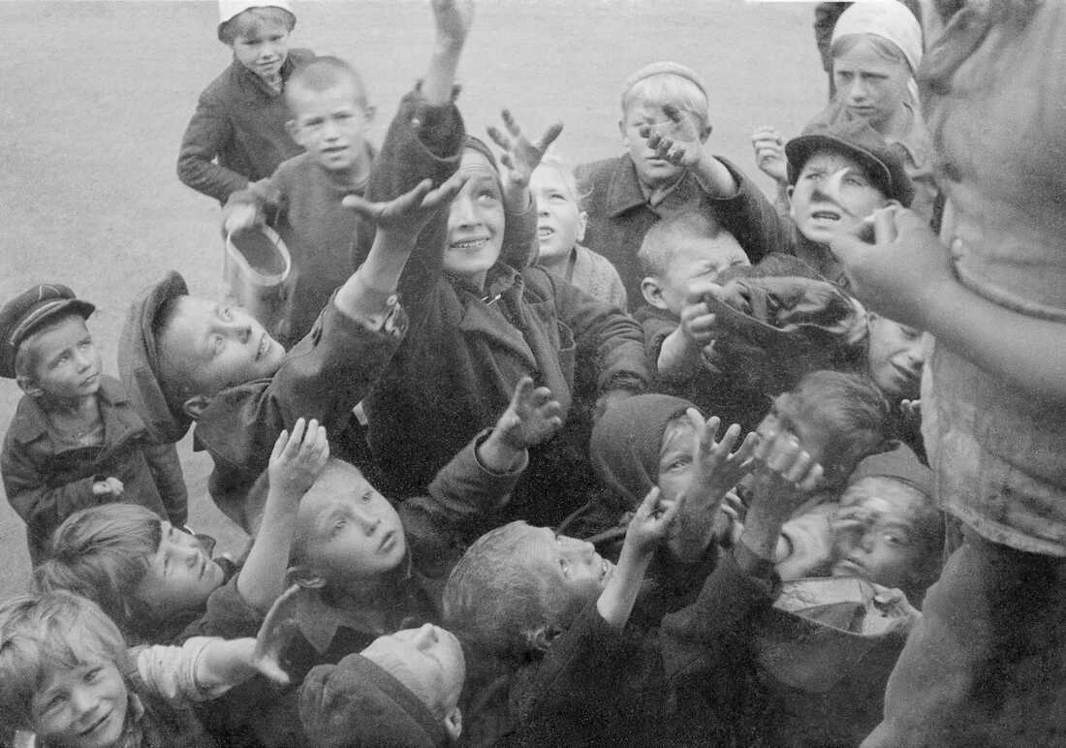
Getty Images. 2018.
Notes:
Russian children clamor for food, circa 1941. During World War II, the Nazis sought to implement a "hunger plan" to starve millions from Russia and Eastern Europe.
The genocide effected by the Nazi regime during World War II, intended for the local population in Eastern Europe, took the form of allocation of daily food rations: 100% for the Germans; 70% for the Poles; 30% for Greeks; 20% for Jews. Hermann Göring, the Reichsmarschall of the Nazi Empire created a blueprint for full alimentation of the occupying German forces through theft of land and food of the Soviet Union thus forcing its "racially inferior" population to starve, adopted on 29 April 1941. In the weeks leading to the German invasion of the Soviet Union in June 1941, the Reich Minister for Food, Richard Darré, and his State Secretary, Herbert Backe, developed the "Hunger Plan", which led to death by starvation of at least seven million Soviet civilians, Jews and gentiles. This article reviews responsibility for the formulation and implementation of this form of genocide.
https://pubmed.ncbi.nlm.nih.gov/34907689/#:~:text=In%20the%20weeks%20leading%20to,Soviet%20civilians%2C%20Jews%20and%20gentiles.
Photo: https://www.npr.org/sections/goatsandsoda/2018/01/19/577659864/author-todays-famines-arent-as-bad-as-you-think-they-are

Slide 6
NBC. 2023.
Notes:
8/2/23 - Russian drones on Wednesday hit a Ukrainian port city along the border with NATO member Romania, causing significant damage and a huge fire at facilities that are key to Ukrainian grain exports following the end of a deal with Russia that allowed Ukrainian shipments to world markets.
Since leaving the deal that allowed Ukraine to export through the city of Odesa, Russia has hammered the country’s ports with strikes. In the past two weeks, dozens of drones and missile attacks have targeted the port of Odesa and the region’s river ports, which are being used as alternative routes.
https://www.nbcnews.com/news/world/russian-drone-strikes-hit-ukrainian-port-key-grain-exports-rcna97723
5 years after the UN resolution 2417
It called on all parties to armed conflict to comply with their obligations under international humanitarian law regarding the protection of civilians and on taking care to spare civilian objects, stressing that armed conflicts, violations of international law and related food insecurity could be drivers of forced displacement.
“…the majority of food insecure people and 75 per cent of all stunted children under the age of 5 living in countries affected by armed conflict, amounting to 74 million people facing crisis food insecurity or worse in situations of armed conflict…”
https://press.un.org/en/2018/sc13354.doc.htm

Slide 7
Agbioscience Economy
Value-Added Food & Nutrition
Animal Health & Nutrition
Plant Science & Crop Protection
Ag Equipment, Tech & Systems
Production Agriculture

Slide 8
1
Accelerate Resiliency
Notes:
Withstand the shocks, disruptions that happen in the food system – innovation is the enabler, and there are companies who are setting the standard.
3/19/24 - Corteva Catalyst - a new investment and partnership platform focused on accessing and bringing to market agricultural innovations … accelerate the development of early-stage technologies that enable farmers to sustainably produce more food and feed
four strategic verticals:
genome editing
biologicals and natural products;
technology platforms; and
decision science.
“Corteva has a long tradition of addressing the critical challenges farmers face around the world by advancing innovation in partnership with the global scientific community,” said Sam Eathington, EVP and Corteva Chief Technology and Digital Officer. “Through Corteva Catalyst, we will build upon that tradition by pairing our considerable expertise and resources with the agility of start-ups and universities to deliver new solutions for farmers globally. This initiative will expand our pipeline and accelerate growth.”

Slide 9
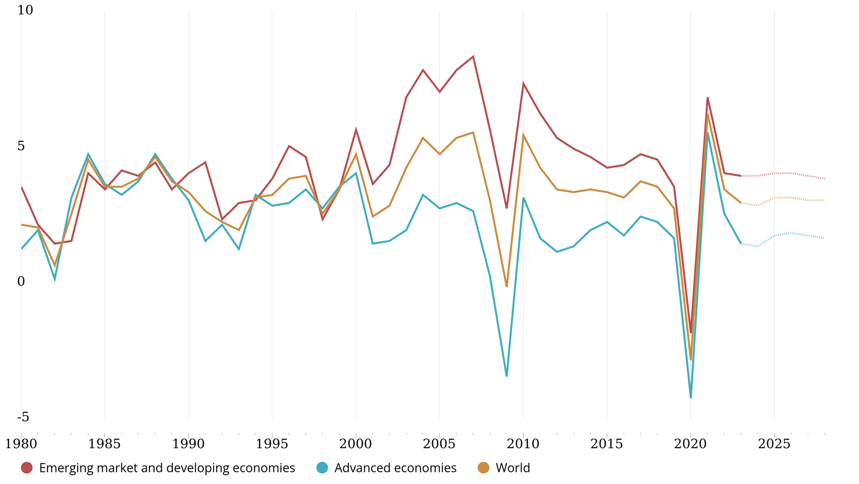
Annual Percent Change
Source: International Monetary Fund. Real GDP Growth. Trend (1980 – 2028).
Notes:
https://www.imf.org/external/datamapper/NGDP_RPCH@WEO/OEMDC/ADVEC/WEOWORLD

Slide 10
Notes:
American journalist Alfred Lewis - “There are only nine meals between mankind and anarchy.” 1906 - https://internationalman.com/articles/nine-meals-from-anarchy/
8 years before his death in 1914

Slide 11
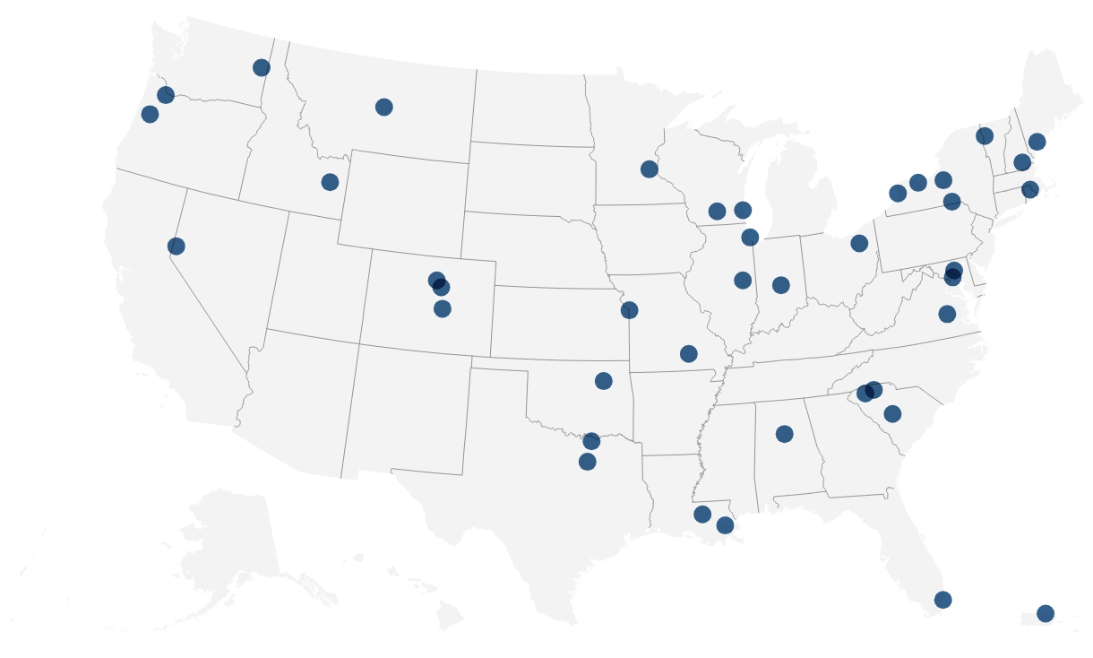
2
Reduce Dependency
U.S. Economic Development Administration. 2023.
Notes:
On October 23, 2023, President Biden announced the designation of the inaugural 31 Tech Hubs
The key technology focus areas are:
Artificial intelligence, machine learning, autonomy, and related advances;
High performance computing, semiconductors, and advanced computer hardware and software;
Quantum information science and technology;
Robotics, automation, and advanced manufacturing;
Natural and anthropogenic disaster prevention or mitigation;
Advanced communications technology and immersive technology;
Biotechnology, medical technology, genomics, and synthetic biology;
Data storage, data management, distributed ledger technologies, and cybersecurity, including biometrics;
Advanced energy and industrial efficiency technologies, such as batteries and advanced nuclear technologies, including but not limited to for the purposes of electric generation https://www.eda.gov/sites/default/files/2023-05/Tech_Hubs_NOFO.pdf https://www.eda.gov/news/press-release/2023/10/23/biden-harris-administration-designates-31-tech-hubs-across-america

Slide 12
70%
Global Glyphosate Production
Occurs in China
Notes:
https://www.buffalo.edu/globalhealthequity/Resources/policy-briefs/issue-13--growing-agrichemical-ubiquity-new-questions-for-environments-and-health.html#:~:text=Chinese%20production%20has%20become%20dominant,the%20US%20or%20the%20EU
China now produces 56% more pesticide active ingredients than either the US or the EU.
Glyphosate is the active ingredient in many herbicides. Weedkillers containing it are used on nearly half of all planted acres of corn and soybeans in the U.S., though much of those are not grown for human consumption. https://www.nbcnews.com/data-graphics/toxic-herbicides-map-showing-high-use-state-rcna50052

Slide 13
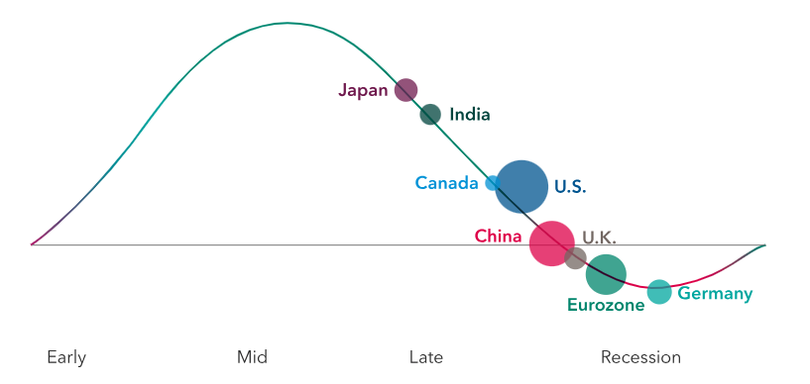
Notes:
Expect mixed results for global economic growth in 2024
Under the weight of elevated inflation and high interest rates, the world’s major economies are diverging. Surprising resilience in the United States, Japan and India is helping to boost the global economic outlook for 2024, while ongoing signs of weakness in Europe and China are tempering expectations for the new year. The world’s two other largest economies, Europe and China, are expected to weigh on global growth as both struggle with an increasingly difficult environment for trade and rising geopolitical tensions.
Germany, the biggest economy in Europe, is already contracting due to a sharp slowdown in manufacturing activity and waning demand from China, its largest trading partner. Meanwhile, the full 20-member eurozone and the U.K. are flatlining and could have a more difficult time if energy prices continue to rise as drastically as they have over the past two years.
More than 60 countries representing half the world’s population will go to the polls in 2024, with an estimated 4 billion people voting in presidential, legislative, and local elections. Those elections will range from the massive — India’s multi-day legislative elections (the largest in the world) and Indonesia’s presidential poll, the world’s biggest single-day vote — to tiny North Macedonia’s presidential election.
https://www.capitalgroup.com/advisor/insights/articles/2024-economic-outlook.html?cid=p78949972612&ad_id=685104271366&ext_id=&gad_source=1&gclid=Cj0KCQiAy9msBhD0ARIsANbk0A96Jx7dq9lBphuIBI5kWYuOq7lzOXamonK5abF4fhSAGe9jwc0HCS4aAhh0EALw_wcB&gclsrc=aw.ds

Slide 14
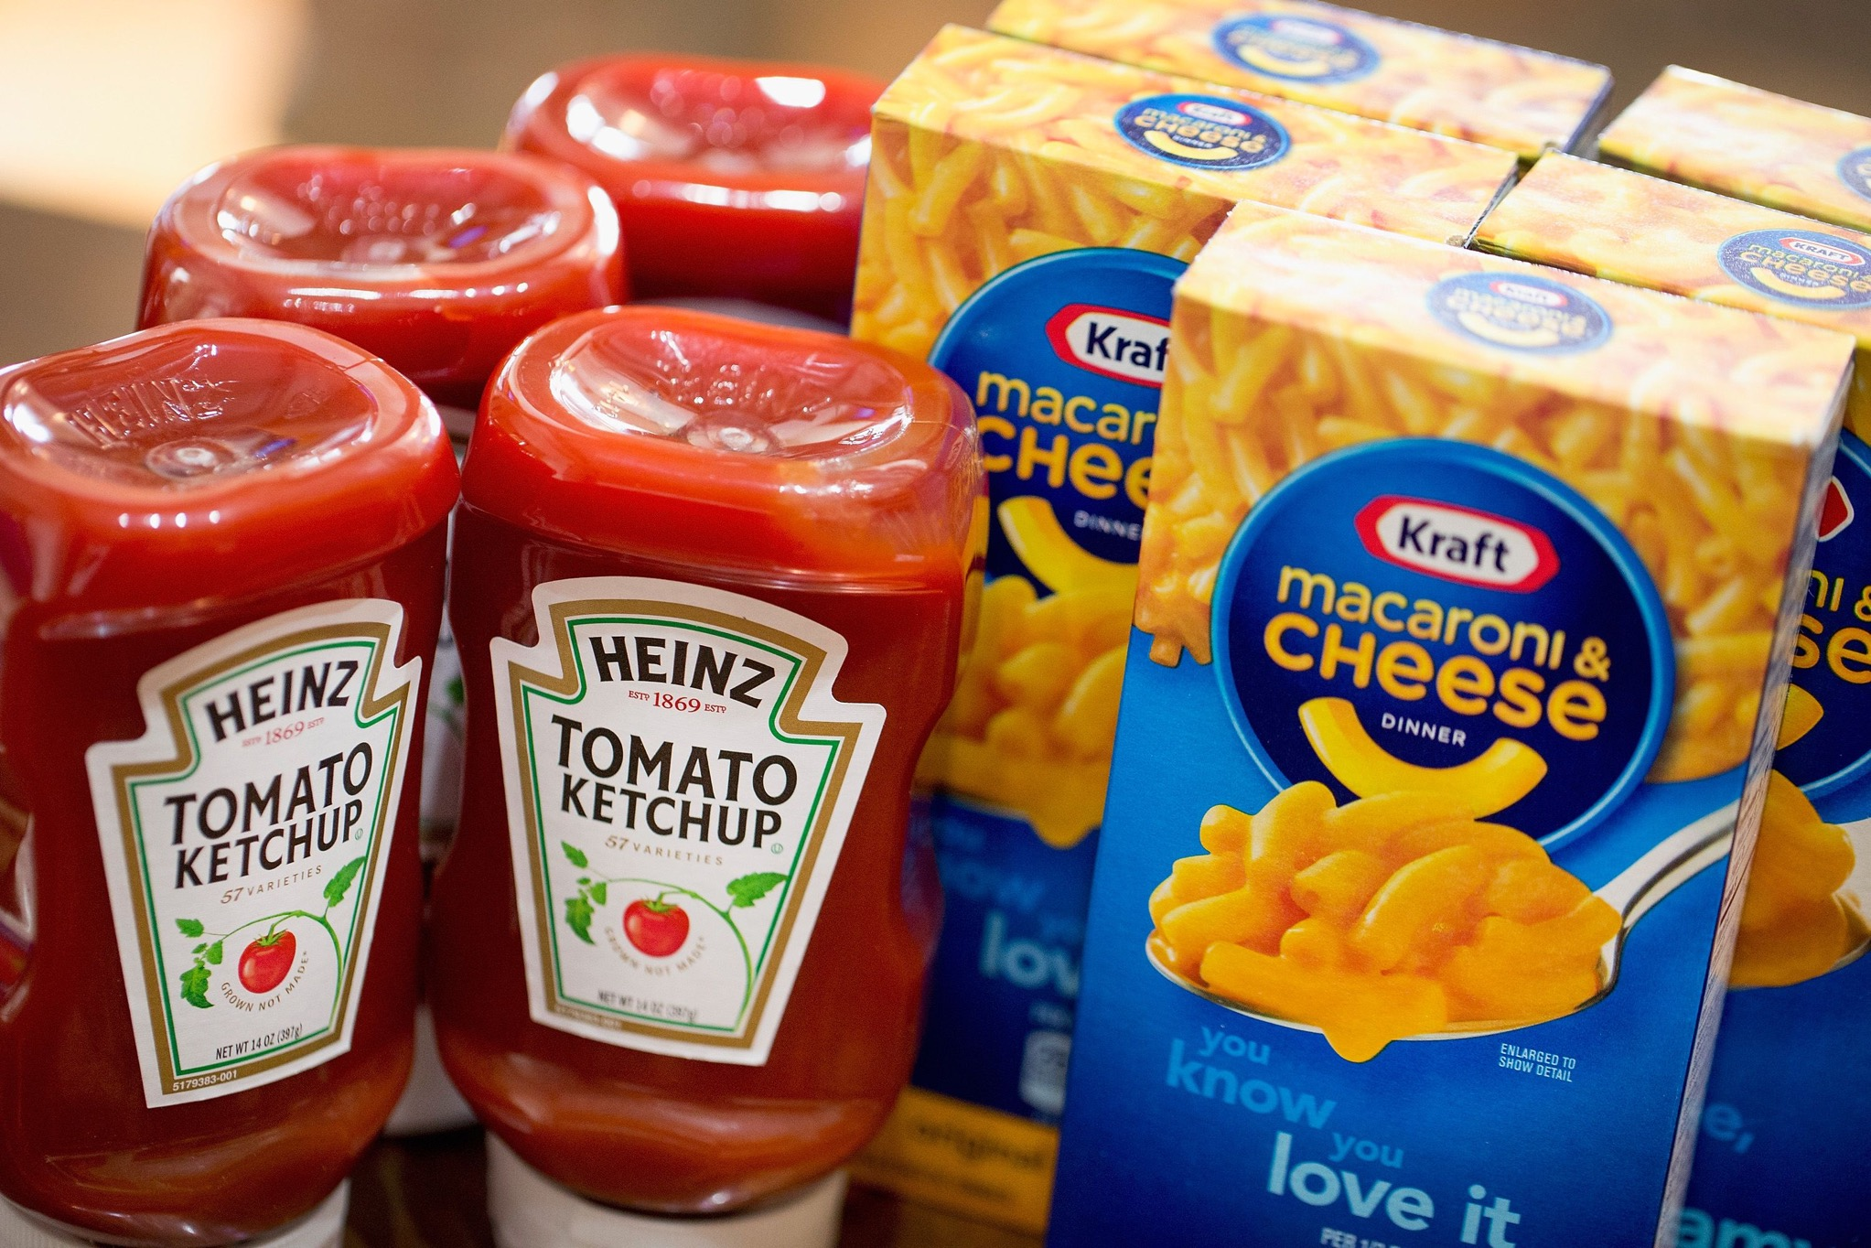
3
Innovate for Health
Frontiers in Nutrition. 2023.
Notes:
Reformulating packaged foods has the potential to improve the nutrient density of the global diet. The WHO’s recommendation is to achieve a 30% relative reduction in mean population intake of sodium by 2025.
The Kraft Heinz Company’s approach to product (re)formulation to develop healthier product lines that are lower in saturated fats, total sugars, and sodium, and contain health promoting components.
KHC’s 2025 ESG nutrition commitments include: achieve 85% compliance with KHC’s global nutrition targets, reduce total sugar in products by more than 60 million pounds across the global portfolio and reduce sodium by 5% in Kraft BBQ sauce and salad dressings, in North America (34).
As one example of sugar reduction, in August 2022, KHC’s CapriSun in the United States and Canada, launched reformulated juice drink pouches with an average of 40% less sugar than the original product. Each 6 fl. oz. serving (177 mL) now has an average of 8 g of total sugars and 5 g of added sugars. The sugar reduction in CapriSun accounts for more than half of the proposed sugar commitment.
Nutrient density refers to the amount of nutrients a food contains per unit of energy it provides and nutrient dense foods are those high in nutrients but relatively low in energy (2). Increasing rates of overweight and obesity represent a form of malnutrition and are a driver for diet related chronic diseases, such as cardiovascular disease, type 2 diabetes and some types of cancer (3). The World Health Organization (WHO) has encouraged product reformulation by the food industry, with an emphasis on reducing energy and removing excess fat, sugar and salt/sodium from the global food supply
https://www.frontiersin.org/articles/10.3389/fnut.2023.1104617/full

Slide 15
$173 Billion
Annual Cost of Obesity in U.S.
Notes:
Obesity affects 20% of children and 42% of adults, putting them at risk of chronic diseases such as type 2 diabetes, heart disease, and some cancers. Over 25% of young people 17 to 24 are too heavy to join the US military. Obesity costs the US health care system nearly $173 billion a year.
https://www.cdc.gov/chronicdisease/about/costs/index.htm#ref6

Slide 16
3 Actions to Secure America’s Security Through Food
1
Accelerate Resiliency
2
Reduce Dependency
3
Innovate for Health

Slide 17
#1 AgTech podcast globally

Slide 18
Food. The Cornerstone of National Security
Mitch Frazier
@Mitchdf
@AgriNovusIN

